Slide 1

FOOD SCIENCE AND ENGINEERING, VALUE –ADDITION AND NATIONAL DEVELOPMENT
Dr. W. A. Adebayo
(Food Process Engineering)
adebayow@oauife.edu.ng; +234808060410278
Department of Food Science and Technology
Obafemi Awolowo University, Ile-Ife

Slide 2

INTRODUCTION

Slide 3
KEY WORDS
Food Science: Food Science can be defined as the study of the physical, microbiological, and chemical makeup of food.
Food Technology: This is the application of food science to the selection, preservation, processing, packaging, distribution, and use of safe food.
Food Engineering: This is the multidisciplinary field that applies engineering principles, such as chemical, mechanical and process engineering to the production, processing, preservation and distribution of foods.

Slide 4
Branches of Food Science:
Food Chemistry
Processing
Food Nutrition
Food Microbiology
Food Sensory
New Product Development
Branches of Food Engineering:
Food Safety Engineering
Sustainability and waste management
Process Engineering;
Packaging Engineering
Equipment Design
Refrigeration and Cold Chain

Slide 5


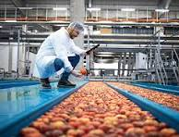
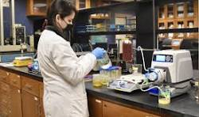
Plate 1: Pictorial view of food experts on duty

Slide 6
KEY WORDS (Cont’d)
Value-Addition: This involves foods transformation of raw agricultural produce into more desirable, convenient, and nutritious products to increase their market value, shelf life and consumers’ acceptability
Impact of value addition to National Development: Value addition contributes to national development by driving economic growth, improving FOOD SECURITY and fostering social progress –
economic growth; FOOD SECURITY and waste management; rural development; health and nutrition; industrial and technological advancement

Slide 7
Food Security
Food security only exists when all people, at all times, have physical and economic access to sufficient, safe and nutritious food that meets their dietary needs and food preferences for an active and healthy life.
This definition of Food Security points to the following dimensions of food security:
Food availability: The availability of sufficient quantities of food of appropriate quality, supplied through domestic production or imports (including food aids).

Slide 8




Plate 1: Impact of food security

Slide 9
Food Security (Cont’d)
Food access: Access by individuals to adequate resources (entitlements) for acquiring appropriate foods for a nutritious diet – entitlements
Utilization: Utilization of food through adequate diet, clean water, sanitation and health care to reach a state of nutritional well-being where all physiological needs are met.
This brings out the importance of non-food inputs in food security.

Slide 10
Food Security (Cont’d)
Stability: To be food secure, a population, household or individual must have access to adequate food at all times.
They should not risk losing access to food as a consequence of sudden shocks (e.g. an economic or climatic crisis) or cyclical events (e.g. seasonal food insecurity).
The State of Food Security in Nigeria
National food security is the ability of a country to ensure on a long-term basis that its food systems provide the total population with access to timely, reliable and nutritionally adequate supply of food

Slide 11
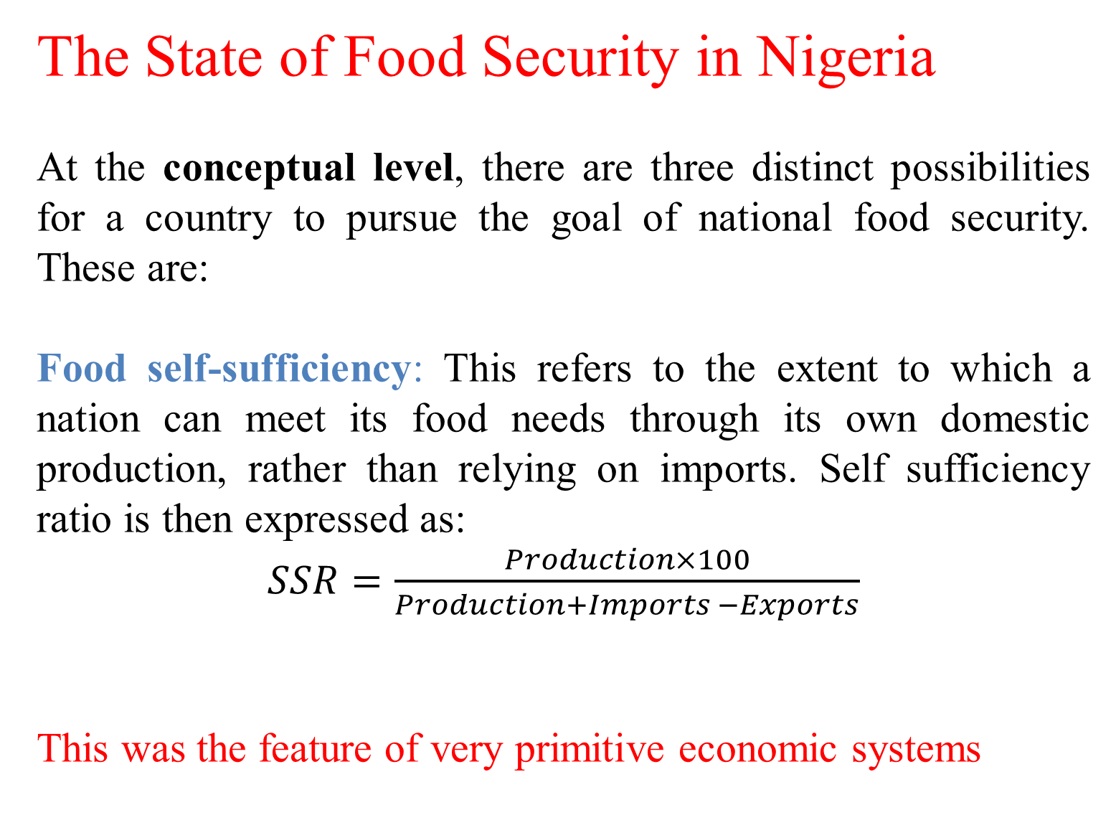
The State of Food Security in Nigeria
At the conceptual level, there are three distinct possibilities for a country to pursue the goal of national food security. These are:
Food self-sufficiency: This refers to the extent to which a nation can meet its food needs through its own domestic production, rather than relying on imports. Self sufficiency ratio is then expressed as:
$SSR=\frac{Production×100}{Production+Imports −Exports}$
This was the feature of very primitive economic systems

Slide 12
The State of Food Security in Nigeria
Autarky: this is the situation whereby a country embarks on a deliberate economic policy of isolating itself in order to attain food self-sufficiency and eliminate international trade. It is the opposite of free trade and open market system
Some Asiatic countries have tried this extreme form of economic policy in the past
A notable example was China during the Cultural Revolution led by the late Mau Tse Tung; Japan Isolation; North Korea

Slide 13
The State of Food Security in Nigeria
Food self-reliance: this means that a country is in firm control of its food needs and supplies through an integrated management of food production, export, import, storage, and distribution. Such a country produces those foods in which it has a comparative advantage.
In addition, the country maintains strategic food reserves to cope with emergencies such as in times of natural disasters via INDUSTRIAL REVOLUTIONS
What is the Present State of Food Security in Nigeria – Causes and Probable Solutions?????

Slide 14
INDUSTRIAL REVOLUTIONS
By the word “revolution”, we mean “abrupt and radical change”.
Although there is no society is static – every society is perpetually in transition.
An Industrial Revolution (IR) occurs when new technologies and or novel ways of perceiving the world trigger profound change in economic systems and social structures
Causative agents of any IR: Energy; Communication and Transportation

Slide 15
INDUSTRIAL REVOLUTIONS
Prior to IR, there was an Agrarian Revolution- Prior to this revolution, early men and women were foraging, they were merely gatherers of fruits and hunters of animals.
The transition from foraging to farming and domestication of animals, using the combined efforts of humans plus animals led to significant changes to:
Energy/Production systems
Transportation systems
Communication systems

Slide 16

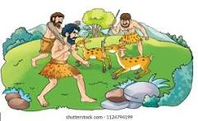
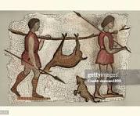
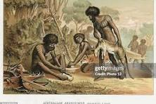
Plate 1: Some adventures during Agrarian revolution

Slide 17
INDUSTRIAL REVOLUTIONS
First Industrial Revolution
This happened in the mid-18th to mid-19th Century. Precisely 1760 – 1840 in Britain. It marked transition from muscle/animal power to mechanical power. The transition to use of machines led to the birth of the factories.
This First Industrial Revolution (1IR) also led to changes in
Energy/production systems,
transportation systems, and
communication systems.

Slide 18
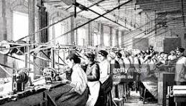
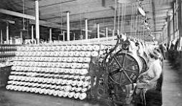
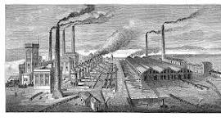
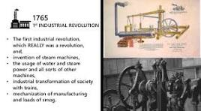
Plate 1: Some Impacts of First Industrial Revolution

Slide 19
INDUSTRIAL REVOLUTIONS
Second Industrial Revolution (2IR)
It occurred late in the 19th to early 20th Century. Precisely 1860 – 1930. It was heralded by the:
advent of electricity, that is, electric power,
electrically driven production and assembly lines.
This massive leap in power generation gave birth to mass production or manufacturing economy.
The 2IR also led to changes in:
Energy/production systems;
Transportation systems, and
Communication systems.

Slide 20
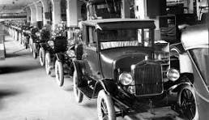
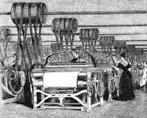
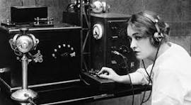
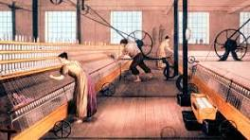
Plate 1: Some Impacts of Second Industrial Revolution

Slide 21
INDUSTRIAL REVOLUTIONS
Third Industrial Revolution (3IR)
It began in the 1960s. This was/is the COMPUTER and INFORMATION age.
It was/is catalyzed by Development of semiconductors
Mainframe computing of the 1960s
Personal computing in the 1970s + 1980s
Internet of the 1990s

Slide 22
INDUSTRIAL REVOLUTIONS
Third Industrial Revolution (3IR)
Its main driver is the convergence of the following technologies:
Renewable energy – which could lead to energy internet;
ICT – Clever Software + Internet
3D- Printing
Actually, the myriad of converging technologies include– clever software, novel materials, more dexterous robots, new processes, and 3D –printing. These are the wonders of the 3IR.

Slide 23


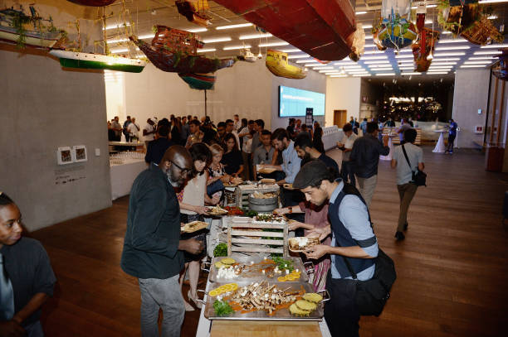

Plate 1: Some Impacts of Third Industrial Revolution

Slide 24
INDUSTRIAL REVOLUTIONS
Fourth Industrial Revolution (4IR)
It began at the turn of the century, that is, about 2000. It is actually an offshoot of the 3IR, because it builds on computer and information revolutions.
It is the fusion of different technologies and their interaction across the physical, digital and biological domains that make the 4IR fundamentally different from previous IRs.
With this glaring evidences, some academicians and thinkers do not think it is different from the 3IR.

Slide 25
INDUSTRIAL REVOLUTIONS
Fourth Industrial Revolution (4IR)
The distinguishing characteristics of the 4IR are
Much more ubiquitous and mobile internet
Smaller and more powerful sensors that have become cheaper
Artificial Intelligence (AI) and Machine Learning
By enabling “SMART FACTORIES” the 4IR creates a world in which virtual and physical systems of manufacturing cooperate with each other in a flexible way.

Slide 26
INDUSTRIAL REVOLUTIONS
Fourth Industrial Revolution (4IR)
The impacts of the 4IR are HISTORIC, PROFOUND, DISRUPTIVE and MULTIFACETED, resulting in disruption of incumbents and reshaping of production, consumption, transportation and delivery systems.
This PARADIGM SHIFT is fundamentally changing the way we live, work, and relate to one another.

Slide 27
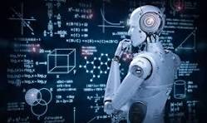
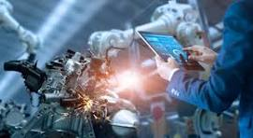

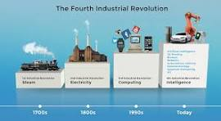
Plate 1: Some Impacts of Fourth Industrial Revolution

Slide 28
Fourth Industrial Revolution (4IR)
The clusters of 4IR are:
Physical
Digital and
Biological.
All three are deeply interrelated and the various technologies benefit from each other based on the discoveries and progress each makes.

Slide 29
Physical MegaTrend
Autonomous vehicles – This includes driverless cars, trucks, drones, aircrafts, boats and submersibles.
3D Printing: 3D Printers are capable of creating a physical object by printing layer upon layer from a digital 3D drawing or model.
Advanced Robotics: Robots were previously employed for tightly controlled tasks. But now, advanced robots are now used across all sectors ranging from military, to nursing, and agriculture and in fact all sectors of the economy.
Modern Robots are now accessing information remotely and act autonomously instead of being programmed.

Slide 30
Fourth Industrial Revolution (4IR)
Physical MegaTrend
New Materials- New smart materials that are self-healing, self-cleaning, and metals with memory (which can revert back to their original shapes) are being invented. For example – Graphene, an advanced material which is 200 times stronger than steel, one million times thinner than human hair and also a good conductor of heat and electricity has been discovered.

Slide 31
Fourth Industrial Revolution (4IR)
Digital MegaTrend
Internet of Things (IoT): This describes physical objects with sensors, processing ability, software and other technologies that connect and exchange data with other devise and systems over the internet or other communication networks.
Billions of devices – smartphones, tablets, and computers are connected to the Internet and also interconnected.
Such monitoring systems can be used to monitor movement and trailing of objects and people.

Slide 32
Fourth Industrial Revolution (4IR)
Biological MegaTrend
These trends are mainly in Genetics, not in the realm of simple biotechnology, or bioengineering or genetic modification. Huge computing power in the field of Bioinformatics has made it possible.
Some of its benefits are:
Increasing ease of gene sequencing
Gene activation
Gene editing- ability to edit DNA and alter traits
Synthetic biology – ability to customize by writing DNA

Slide 33
Fourth Industrial Revolution (4IR)
How do I prepare to manage the impacts of the Fourth Industrial Revolution (4IR)?
We can navigate the disruption and confusing tendencies of the 4IR by:
Harnessing the benefits, and
Mitigating the disruptive influences.
The fourth industrial revolution may be driving disruption, but the challenges it presents are of our own making.
We can only meaningfully address these challenges if we mobilize the collective wisdom of our minds, hearts and souls.

Slide 34
Fourth Industrial Revolution (4IR)
How do I prepare to manage the impacts of the Fourth Industrial Revolution (4IR)?
To do so, we must adapt, shape and harness the potential of disruption by nurturing and applying four different types of intelligence:
Contextual intelligence: Having to do with the mind. This is about how we understand and apply our knowledge. It is a prerequisite for adaptation and survival.
Emotional intellective: Having to do with the heart. This is about how we process and integrate our thoughts and feelings and relate to ourselves and to one another.

Slide 35
Fourth Industrial Revolution (4IR)
How do I prepare to manage the impacts of the Fourth Industrial Revolution (4IR)?
Inspired intelligence: Having to do with the soul. This is about inspiration from the spiritual realm. Alongside contextual and emotional intelligence, there is a third critical component for effectively navigating the fourth industrial revolution.

Slide 36
Fourth Industrial Revolution (4IR)
How do I prepare to manage the impacts of the Fourth Industrial Revolution (4IR)?
Physical intelligence: Having to do with the body. This is about self-preservation. Contextual, emotional and inspired intelligence are all essential attributes for coping with, and benefitting from, the 4IR.
The physical intelligence involves supporting and nourishing personal health and well-being.
Advances such as implantable technologies, telemedicine have positive effects on our physical intelligence BUT

Slide 37
Impacts of Fourth Industrial Revolution (4IR) on Value-addition in Food Systems:
Enhanced processing and efficiency – automation and robotics; IoT and smart sensors
Improved product quality and innovation – AI and machine learning; 3D food printing;
Supply chain optimization – block chain and traceability; cold chain technologies
Consumer – centric value addition – big data and AI; smart packaging;

Slide 38

Now that 5IR is fast approaching, what are your Plans/Preparations?

Slide 39

THANK YOU ALL FOR YOUR ATTENTION!

